Slide 1
Week 5
Inflation Targeting Part 4

Slide 2
Concluding topics on inflation targeting
Continuing the theme of unresolved issues in the policy framework post-GFC:
The ZLB
Bernanke’s menu of options
Turner’s case for OMF
Negative interest rates as an alternative solution to ZLB (Rogoff)
2. Monetary policy and asset bubbles (Gruen, Plumb and Stone)
3. Relationship between monetary and financial stability policies (Edey)

Slide 3
Rogoff (2017) on negative nominal interest rates
Average rate cut needed to fight recession in US = 5.5 per cent
Hence, risk of unstable deflation trap if R can’t go negative
Substitution into currency the main obstacle
Possible reasons for persistent low interest rates:
secular stagnation/legacy of the GFC
lower trend productivity growth
increased global supply of savings
increased demand for safe assets
all of which imply: lower ‘neutral’ real interest rate (= r*)
Note the Taylor rule: R = π + r* + ½ (inflation gap) + ½ (output gap)

Slide 4
Rogoff (2) Possible solutions to ZLB
Forward guidance – seen as ineffective
QE/helicopter money: Rogoff opposes on governance grounds (long run inflation risk)
Raise the inflation target – undermines target credibility
the target is not an instrument unless it is super-credible
Rogoff’s solution: re-engineer the currency to allow negative nominal interest rates

Slide 5
Technical solutions to problem of currency substitution
Four options
Cashless society – all transactions and balances are electronic (hence, no option of large-scale currency substitution)
Interest (+ or - ) on printed currency notes (physical or electronic time stamping as to date of issue)
Sliding exchange rate between bank reserves and printed currency
Abolish high-denomination notes: limits but does not eliminate cash subsitution
Rogoff considers 3 and 4 to be the most promising options
Conclusion: negative R may be needed, ZLB ‘not an immutable constant’
But: Policy makers to date have shown little enthusiasm for this solution

Slide 6
2nd unsettled question: should monetary policy respond to asset price bubbles? And if so, how?
What is an asset bubble?
General rise in a class of asset prices above fundamentals because they are expected to rise further
It will eventually collapse, but timing is unpredictable
“Fundamentals” are not directly observable, so you can’t be sure you are in one
Examples: 1990s tech bubble, real estate bubbles

Slide 7
Characteristics of bubbles
General optimism (“This time it’s different”)
There may be elements of fraud
Often associated with leverage – borrowing to buy assets
amplifies both the upside and the downside of asset speculation
Increased participation in speculative behaviour
Literature on “rational bubbles” – asset price expected to increase by exactly enough to compensate for the probability of collapse

Slide 8
Relevance for monetary policy
Expansion phase of a bubble may add to demand, growth and inflation. People feel richer/more optimistic and therefore spend more
This would elicit some policy response under normal criteria (eg, a Taylor rule)
Associated leverage and risk to financial stability when the bubble collapses
Monetary policy setting determines the price of credit and may therefore influence the probability of a bubble forming or collapsing

Slide 9
The debate
This first began to be seriously debated in the 1990s due to Japan’s experience (‘bubble economy’) and the 1990’s tech-stock bubble
The question: within an inflation targeting framework, should the reaction function be modified to “lean against” an identifiable asset bubble?
Or alternatively, ignore the bubble but use monetary policy aggressively to clean up the damage afterwards
This became know as the “lean vs clean debate”

Slide 10
Lean vs clean 1
Lean
bubbles are too damaging to ignore
monetary policy can influence the probability of a bubble forming
cheap credit encourages borrowing to buy assets
more general proposition: policy should not ignore relevant information, including information about asset prices
it is never optimal to ignore relevant information

Slide 11
Lean vs clean 2
Clean
the Friedman legacy: limited objectives to avoid doing harm by misguided activism
not enough information to identify a bubble
the Greenspan view (1990s tech bubble): you only know you’ve been in a bubble after it has collapsed
effect of MP on asset prices is highly uncertain
MP is a powerful tool for cleaning up afterwards
don’t lose the clarity of inflation targeting by appearing to target asset prices

Slide 12
State of the debate in policy setting institutions
The debate is considered inconclusive
CBs have sometimes talked as though they were reacting to asset bubbles and sometimes as though bubbles should be ignored
They are sometimes criticised for responding to asset prices, but also for failing to respond
We will study a model which helps explain why the debate has been hard to resolve in practice

Slide 13



Model-based analysis of the debate
Source: Gruen, Plumb and Stone (GPS), 2005
The model
Two equation model of aggregate demand and supply (Phillips curve):
Augmented with asset-bubble term which adds to demand:
Hence:

Slide 14


GPS model (contd)
CB sets r to minimise the loss function:
Analytical solution:
This is a kind of “aggressive” Taylor rule.
GPS focus on how should the policymaker respond during the expansion phase of the bubble (everyone agrees on the ex post clean up).

Slide 15
Interpretation of the model
All variables are expressed as deviations from steady state/optimum
Output is mean-reverting and can be influenced by the policy instrument r (the real interest rate)
Inflation accelerates when output is above normal
An observable asset bubble either adds to demand with probability (1 – p) or collapses and reduces demand with probability p
The longer the bubble has been expanding, the greater the damage when it collapses
The policymaker chooses r as a function of observable variables in order to minimise a weighted average of output and inflation variability
Calibration is empirically based

Slide 16
Decision-making structure
The model studies only the expansion phase.
At each stage, GPS posit two policy advisers:
a ‘sceptic’ who ignores the bubble (apart from its observable effects on prices and output)
an ‘activist’ who knows the stochastic process generating the bubble and leans against it
These represent the cleaner and the leaner
The sceptic’s advice is always accepted, and then new advice is formed in the next period
This is to test the case for switching to an activist approach at each stage of an expanding bubble.

Slide 17
Extensions to the basic model
Policy affects the probability of the bubble collapsing
Policy affects rate of growth of the bubble in the expansion phase
Bubble takes longer to collapse
Rational bubbles

Slide 18
Economic relevance of the model
In this set up, the activist will always generate better outcomes, because she/he is incorporating more information in the policy response and has full information
The interesting questions are:
what does an optimal activist policy decision look like at any given point in the process?
how does it differ from the sceptical policy?
is it likely that the activist would have enough information in practice to be confident of doing better than the sceptic?
… or even knowing the correct direction of response?

Slide 19
Interpreting the results
The results show, at each stage of the process, the interest rate recommendation of the sceptic and the activist, assuming the sceptic’s advice has been followed up to that point
Hence, it tests how strongly the activist would want to differ from the sceptic at each stage of the process
Allows sensitivity analysis to changes in parameters/assumptions

Slide 20
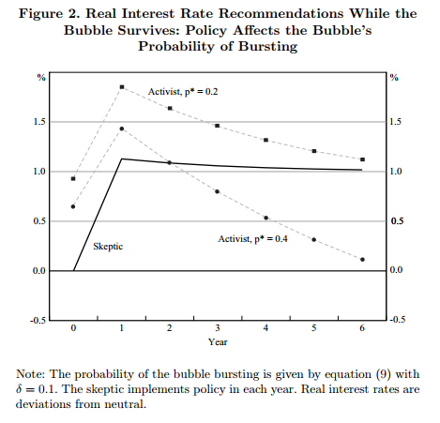
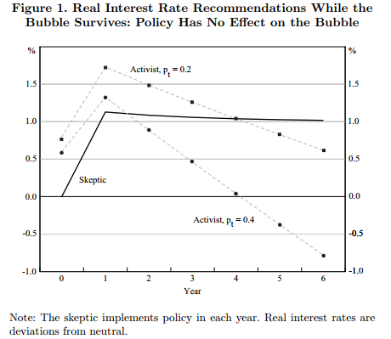
Results 1, 2 (recall: p is the probability of the bubble bursting in each period)

Slide 21
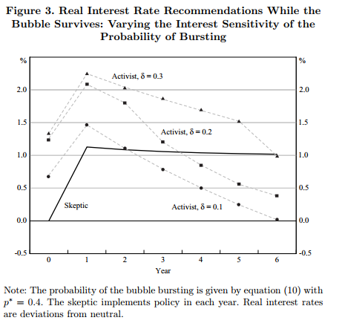
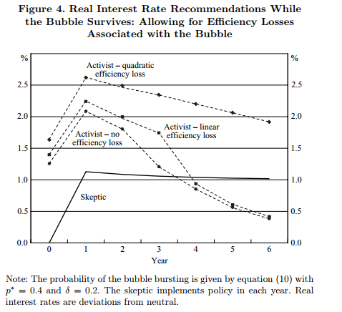
Results 3,4

Slide 22
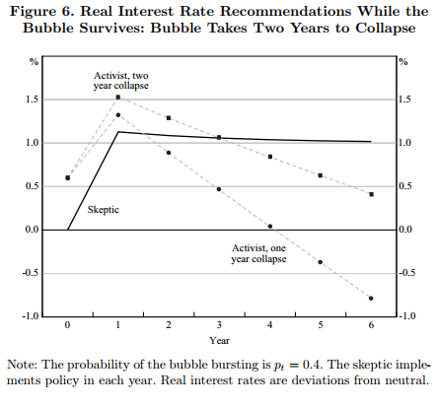
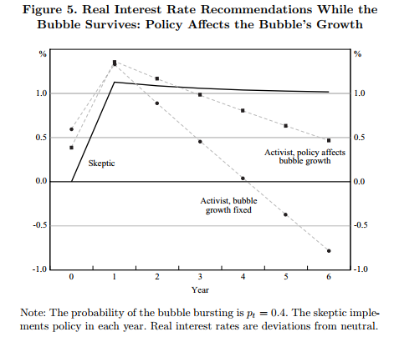
Results 5,6

Slide 23
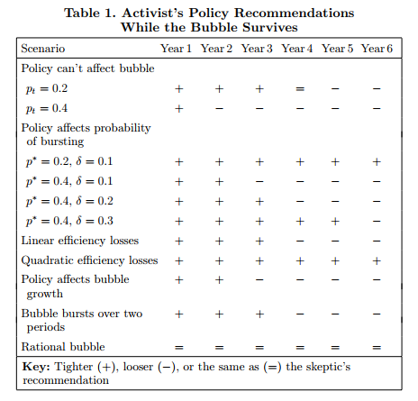
Summary

Slide 24
GPS conclusions
Optimal to ‘lean against’ some bubbles but not others
with complete knowledge, it is sometimes optimal to lean with a bubble
The theoretical case to ‘lean against’ is clearest in the early stage
but, that is also when a bubble is hardest to identify
In later stages, the interaction of impact lags and larger cost of collapse can change the direction of optimal policy
These results assume the policy maker has perfect information
With imperfect information, an activist policy could make a directional mistake
Hence: it is theoretically possible to improve on the sceptical approach, but without full information the activist approach could make things worse not better

Slide 25
Financial stability policy: what is it?
Prevent/mitigate asset and credit booms and busts with monetary policy: the “lean vs clean” debate
CB as lender of last resort: to combat runs on banks and government. CB can swamp a “fear equilibrium” with unlimited liquidity
to be covered in more detail in a future lecture
Market maker for stressed markets (eg government and private securities)
Prevention/mitigation of solvency crises (prudential policies)

Slide 26
The CB as lender of last resort
Banks engage in maturity transformation and are therefore vulnerable to runs, even if solvent
Banks can fail in a panic of forced to sell assets at ‘fire-sale’ prices
Deposit insurance will mitigate but not eliminate this risk
The Bagehot principle: lend freely, at a penalty rate, on good collateral, to solvent banks

Slide 27
Macro- and micro-prudential policies
A useful distinction, though some see it as artificial because the objectives overlap
Micro: directed at soundness of an institution in isolation (eg, supervision of an individual bank’s risk controls or credit assessment standards)
Macro: directed at the system as a whole. eg excessive system wide lending for a risky activity
real estate speculation
corporate takeovers

Slide 28
Examples of macro-prudential instruments
Countercyclical capital requirements
Time-varying controls on particular types of lending (eg APRA guidance on investor property lending)
Controls on loan-to-valuation ratios in housing lending
Using prudential instruments in a time-varying way to lean against the credit cycle
In recent low interest environment, many jurisdictions have been using these types of policies, especially in relation to property lending

Slide 29
Allocation of responsibilities
Lender of last resort/liquidity management function is innate to the central bank
General consensus that interest rate setting function belongs in the central bank
Less consensus on the allocation of other (regulatory and prudential) functions

Slide 30
Alternative models for allocation of prudential responsibilities
Australia, Canada, Indonesia: integrated prudential regulator separate from the CB
BoE, RBNZ: prudential regulation falls within the CB
US Fed, ECB, BoJ: complex overlapping responsibilities
These arrangements are largely determined by historical legacy

Slide 31
Prudential authority within the CB?
The arguments are not clear cut
Advantages:
Coordination/cooperation
Information sharing
Synergies in professional expertise
Disadvantages:
Too much power in one institution
Too much complexity
Groupthink/loss of diversity in sources of analysis

Slide 32
Coordination arrangements in Australia
Council of Financial Regulators chaired by RBA Governor (RBA plus Treasury, APRA and ASIC)
This is a non-statutory body with no formal powers
Coordinates regulatory actions
Makes recommendations to government where needed (eg during GFC)
This arrangement generally perceived to be working well (unlike in other jurisdictions)
Murray Inquiry (2014) recommended no change

Slide 33
Role of RBA
Liquidity management
Financial stability analysis at macro level (FSR)
Coordination with other agencies in policy development
Information sharing with other agencies
Role in crisis preparedness

Slide 34
Why financial stability policy is unlike monetary policy
Mon. policy has a clearly defined framework of
instrument (interest rate)
objective (inflation target)
strategy (forward-looking Taylor rule)
governance (independent CB accountable to government)
In financial stability policy all these things are less well defined

Slide 35
How should financial stability policy be conducted?
Objective: manage system risks to an acceptable level
Instruments:
CB liquidity tools
capital and liquidity standards
prudential supervision, lending standards etc
Strategy: use the available instruments to ensure
high levels of safety in normal times
tighter risk controls in boom times
stress relief when needed
Governance: as discussed, there is no single consensus model

Slide 36
Summary
Emerging consensus in favour of inflation targeting as the best policy model in normal times
Post GFC: not normal times:
ZLB still operating in some major economies
debt overhang
debate on “unconventional” stimulus measures
Debates on asset prices, financial stability policy still not settled
Emergency Covid responses were successful in providing stimulus
but, have raised inflation concerns
In our seminar and media readings, we are seeing these debates playing out in real time

